Slide 1
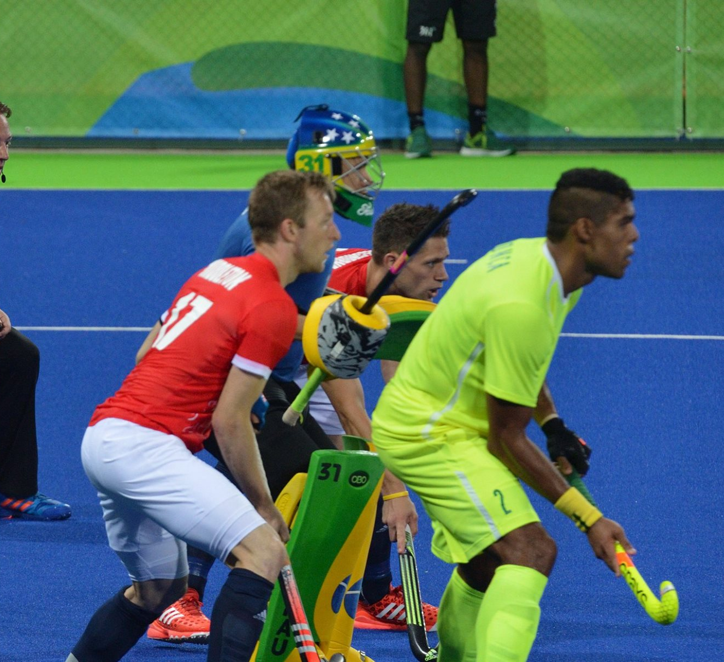
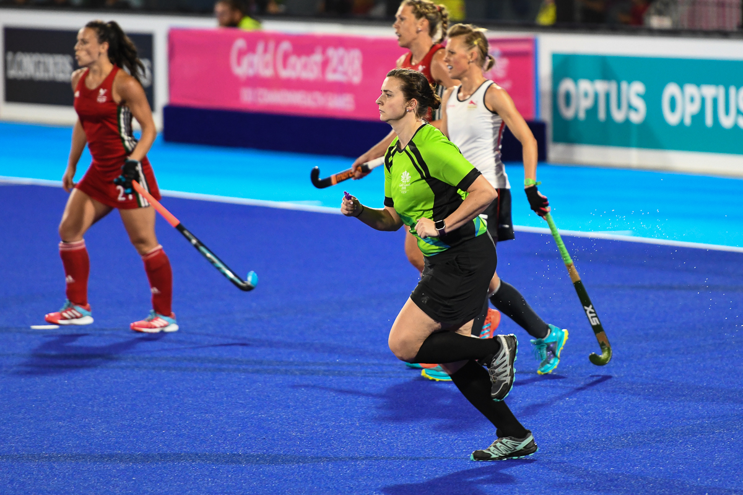
Central Otago Hockey Umpires Briefing 2020

Slide 2
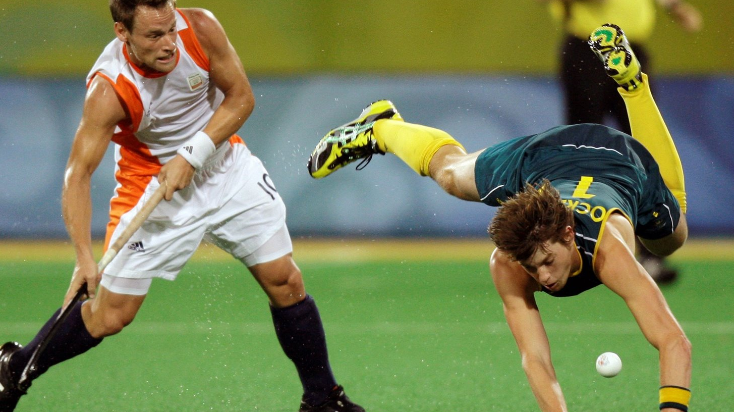
Welcome
Umpire development, coaching and mentoring
NZ HOCKEY umpiring pillars
FUN FAIR SAFE
Without umpires, competitive hockey simply wouldn’t work. Umpires are crucial figures on the hockey turf and each year they officiate thousands of games at all levels of the sport throughout the country.

Slide 3
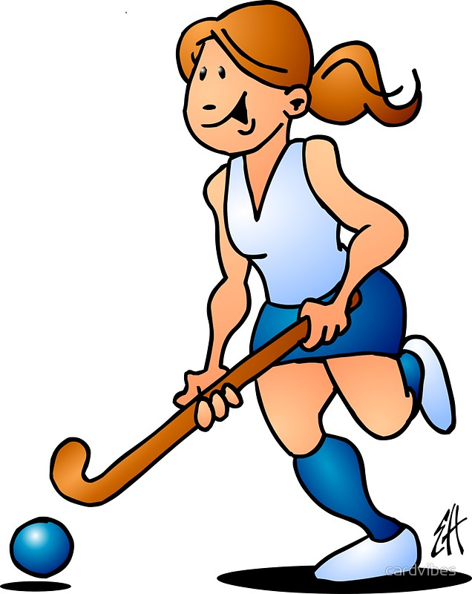
Agenda
Role of an umpire in hockey
Objectives to being a good umpire
Attitude & preparation
Positioning and area of control
Cooperation with fellow umpire
Communication & Signalling
Consistency & Control
Rules review Q & A
Approximately 1 hour ☺

Slide 4
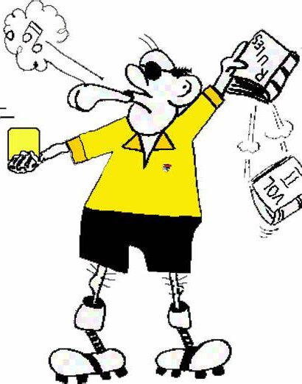
The Role of an umpire in hockey
“The role of an umpire is critical. They make sure everybody plays by the rules… But it is a limited role. Nobody ever went to a game to see the umpire”
The role of an umpire is to control the match, apply the rules and uphold the duty and care of players. This means keeping the game safe by being the judges of fair play.
Each umpire has the primary responsibility for decisions in one half of the field and is *only allowed to award a penalty corner, penalty stroke or goal in their own half; or a free hit to the defenders inside their circle. * can assist or make recommendations to the other umpire
Their duty is to protect skilful play and penalise offences.
Success can be measured by the degree in which the umpire keeps the game flowing within the rules, interfering as little as possible.

Slide 5
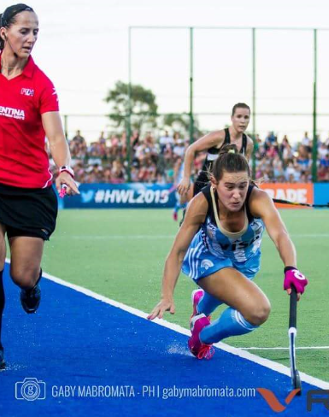
Objectives to being a good umpire
“Aim to become even better with each and every game”
BE APPROACHABLE – by being approachable you can ease tension in the game. This can be achieved through a good connection with the players. Having a good understanding of the rules will help you a lot ☺
BE YOUR SELF – an umpire should be themselves and not imitate anyone else, bring your own natural flare to the game and your umpiring. Show confidence and enjoy yourself, umpiring can be a lot of fun and very satisfying when done well.
LET THE GAME FLOW – as much as possible, allow the game to flow.
BE CONSISTENT – have consistency in your decision making over both teams.
STAY FOCUSSED & IN CONTROL – The game is very fast, any lapse in concentration can be exposed very quickly.

Slide 6
Attitude and Preparation
“Players will react and behave according to the attitude you demonstrate”
Be appropriately dressed (check with COHA for vests), look like umpires
Arrive in time for your games, try to be there 10-15 mins prior to the start of the game ready to go.
Seek out your mentor / buddy, find the other umpire and brief each other prior to the captains coming on.
Show interest and concentration for the entire game, it can be harder to umpire a slower game than a fast one, can be easy to get caught out.
Always be fair, do not pre judge games, teams or individuals on past performances or events.

Slide 7
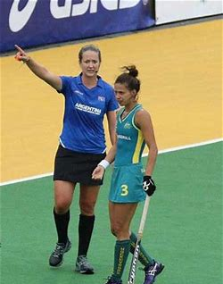
Positioning and area of control
Never guess decisions – Good positioning between yourself and the other umpire (a 45 degree angle), along with cooperation will ensure you are not guessing.
16 yard hits – never stand ahead of the play or inline with the hitter.
Anticipate play – scan off the ball, read the play, this will help you stay ahead. Generally try to stay ahead of play, even if it means you have to sprint to get there. You can rest once your in position.
Positioning in the circle is critical. Correct decisions here are necessary to maintain control of the match, as well as having major effects on its outcome. Do not be afraid to get close to the play/players. Within reason, the closer you are the more you will see.
If you have to crouch down or squat to see (especially in the circle) then you are not in the right position, move yourself around until you can see clearly.

Slide 8
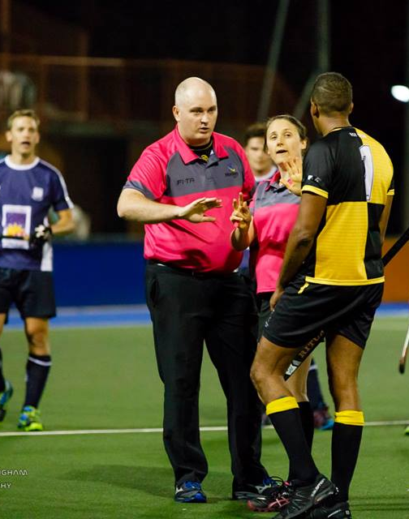
Positioning and area of control (cont.’)
For decisions bordering the umpires area of control, jurisdiction is generally given to whichever umpire the play is coming towards.
Double whistling can be avoided by communication, cooperation and eye contact with your fellow umpire.
Chasing the play and being constantly caught out of position can contribute to overall poor umpiring. Sometimes this cant be helped if the attacking team get a quick breakaways, in this case do your best to catch up and get ahead.
Position is individual, everyone is different. Your height and or speed may allow you to modify where you stand.
Most of all, your ability to read the game will enable you to get in the best position.

Slide 9
Positioning and area of control (cont.’)
When following the ball out of your end do not get too close, make sure you cover the line when coming out of your area on the LEFT hand side. Stay more to the midfield when play exits down the RIGHT.
There is no doubt an umpire who appears to be right on the spot will sell a decision better than one some distance away. This means the closer you are to the play, the easier it is to sell your decision and the more you will see.
Whilst umpiring, try to keep a 45 degree angle from your co-umpire. This will help with vision of the play and assist with easy location of your other umpire when in need of assistance.

Slide 10
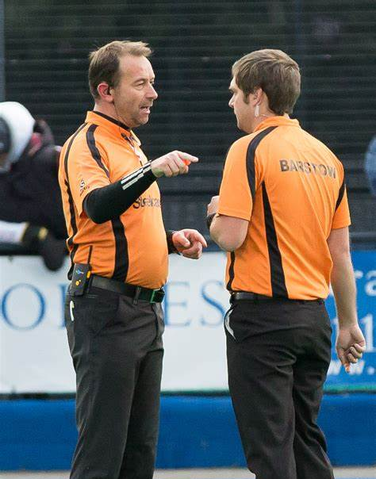
Cooperation with fellow umpire
Have a pre game discussion, discuss areas of control, choose ends, control methods etc.
During the match maintain eye contact regularly with your fellow umpire. Do not let the gap between you and your partner stretch too far apart.
It is very important that you only signal when asked for help by your partner. (your fellow umpire should look up and find you when they are unsure of a decision in their area of control) this is when you signal the call and the reason.
If you are unsure on a crucial decision do not be afraid to consult your fellow umpire. This is done by calling a stop to time and meeting your partner somewhere around the centre of the distance between you at the time. Ensure that when consulting your fellow umpire that no players are able to hear your discussion.

Slide 11
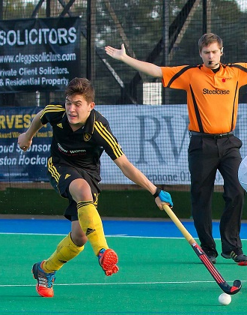
Communication
Have a good solid sounding sharp whistle.
The whistle must be blown decisively and loudly enough for all involved in the match to be able to hear it. This doesn’t mean long loud whistling at all times!
Tone is important to ensure the players know what you as the umpire want to happen without the use of words. * obviously small children's grades are an exception
Reserve loud long and strong whistle blows to communicate when you don’t like what is happening in control situations. i.e. bad tackles / foul play etc
Do not be afraid to speak to players as the game continues. Particularly around playing advantage.

Slide 12
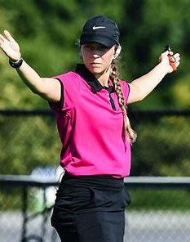
Signalling
Signals must be clear and held up long enough to ensure all players and your fellow umpire are aware of decisions.
Where possible be stationary when giving a signal, if on the run, slow down / stop, signal then continue into position.
Make positive and clear signals.
Directional signals must not be made across the body.
Never turn you back or head on the play or players.
Sell your decision by signalling the reason for your call (especially when awarding PCs or strokes).
Do not signal when play is in your fellow umpires area unless asked.

Slide 13
Consistency
Consistency is a matter of adjusting the mental approach of both umpires to achieve a uniform application of the rules and discipline.
Being consistent will help maintain the respect of players.
Try to blow the same as your fellow umpire when ruling on danger and bad tackles / obstruction. Also remember if you blow a rule a certain way in the first half you must blow it the same way in the second.
Be fair, decisions must be made with a sense of justice and integrity
Concentration must be maintained at all times; nothing must distract an umpire.

Slide 14
Control
Most control problems can be broken down to – Player to player, which is normally physical and player to umpire which is generally verbal.
Control is achieved not exclusively through the use of warnings and suspensions. In all control situations the whistle MUST be the first action, it can also be achieved through:
Displaying the correct attitude to the game and its participants
Clear whistling, signalling and communication, decisions must be made promptly, positively, clearly and consistently.
Correct use of penalties, including cards
Allowing the game to flow
Ensure you maintain the 5m distance at all times
Effective communication

Slide 15
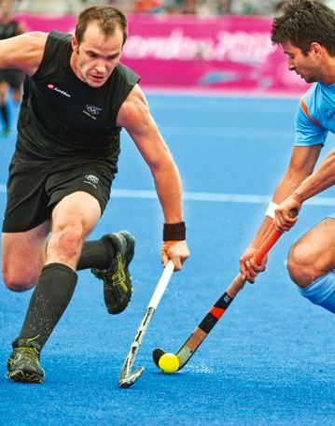
Control – trouble from the side-line
If you have trouble with side-line spectators, players on the bench, coaches or managers. Stop the game and in the first instance…
Senior club games - call the captain over and warn them verbally, ask them to go over and speak to the offenders and request that they stop immediately.
Qwik sticks – Stop the game and speak with your mentor.
If it does not stop you have the right to ask the offenders to leave the premises.
If this happens, you will need to report it in writing to the COHA explaining what they were doing, who it was and what team they belong to.

Slide 16
Rule review + Q & A
Take pride in what you do, remember respect for an umpire is created off the field as well as on.
http://hockeynz.co.nz/wp-content/uploads/2020/04/Hockey_NZ_Umpiring_Gbook.pdf

